Slide 1

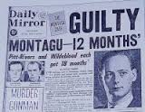
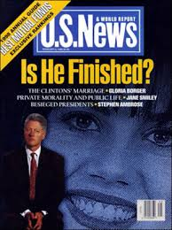
HIST3581: Sex and Scandal in History
Week 1: Introduction to the Course

Slide 2
Teaching Staff
Welcome to HIST3581: Sex and Scandal in History!
Course Coordinator: Dr James Bennett
Teaching Staff: Prof Marguerite Johnson, James Bennett
Guest Lecturers: Dr Kath McPhillips; Dr David Betts

Slide 3
Course Description
This course introduces students to the history of sexuality and constructions of sexuality across a range of nations, periods and geographical regions in the Western world. It provides a chronological and thematic survey of the field including a consideration of homosexuality, heterosexuality and queer, and the multiple ways in which the private and public worlds are interconnected through sex. The course is informed by a wide range of historical resources including non-elite source types such as film and documentary, memoir, tabloid newspapers and sex education literature.

Slide 4
By the end of the course students will be able to:
Explain why sexuality is an important category of historical analysis
1
Compare and contrast moments of sexual crisis within specific historical timeframes and how these historical moments relate to the present
2
Evaluate information, ideas and arguments including those of diverse cultural assumptions
3
Demonstrate advanced research, writing, information literacy and oral communication skills relevant to history.
4

Slide 5
Assessments
 | Assessment Name | Due Date | Weighting
1 | Research Essay (35%) | End of week 11 (11:59 pm, Friday 15 October) | 35%
2 | Essay plan (15%) | End of week 5 (11:59 pm, Friday 27 August) | 15%
3 | Text analysis (20%) | End of week 7 (11:59 pm, Friday 10 September) | 20%
4 | Examination (20%) | The test will be made available on the course BB site and must be completed by the end of week 13 (11:59 pm, Friday 29 October) | 20%
5 | Tutorial participation and contribution to class discussion and debate (10%) | Weekly during semester | 10%

Slide 6
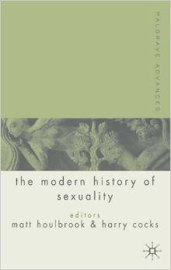
Sexuality in Modern History
Palgrave Advances in the Modern History of Sexuality’, edited by Harry Cocks and Matt Houlbrook (Palgrave, 2006)
‘sex has been used as a prism through which to explore wider social and cultural issues – notions of what is natural, unnatural, normal or pathological and the ways in which those categories are produced and reproduced. In short, the history of sexuality is a protean discipline that allows us to enter a world of meaning, to understand the most fundamental assumptions about everyday life that shape the social, cultural and political life of modern Western societies.’

Slide 7
The Role of Sex in Historical Scholarship
Sex in history only respectable from the 1960s
The rise of social history gave impetus to sexuality narratives
Feminism was key to putting sexuality and gender at the core of historical narrative
By the 1970s sexuality came to be seen as a social phenomenon

Slide 8
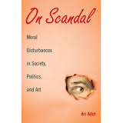
Defining a Scandal
Ari Adut. On Scandal: Moral Disturbances in Politics, Society and Art, Cambridge: CUP, 2008.
Three elements to a scandal
An initial transgression (whether real or apparent or alleged)
Publicisation
A public to respond to the scandal

Slide 9
Theories of Scandal
Traditional theories
Objectivist
Constructivist
Adut’s Theory of Scandal
Publicity is a critical variable
Public response is the driving force
Can be exacerbated by:
Status of the transgressor
Taboo nature of transgression
Whether others are contaminated by the scandal

Slide 10
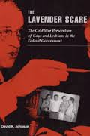
Case Study of the 1950s: Gender, Sexuality and Politics
,
Cold War: traditional emphasis on anti-communism
David K. Johnson, The Lavender Scare (2004)
Most political historians have missed the link between anti-communism, gender and sexuality
Johnson:
‘recent work in cultural history, gender studies, and literary criticism highlights the importance of issues of gender and sexuality to Cold War political culture – how containment of sexuality was as central to 1950s America as containing communism. With the nation on ‘moral alert’ because of the Cold War, stable, monogamous, heterosexual marriages were seen as a key weapon in the arsenal against degeneracy and internal Communist subversion.’ (10-11)

Slide 11
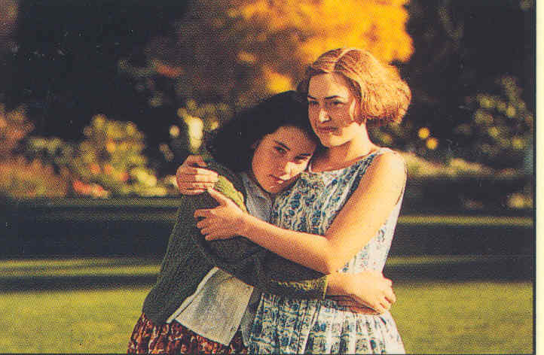
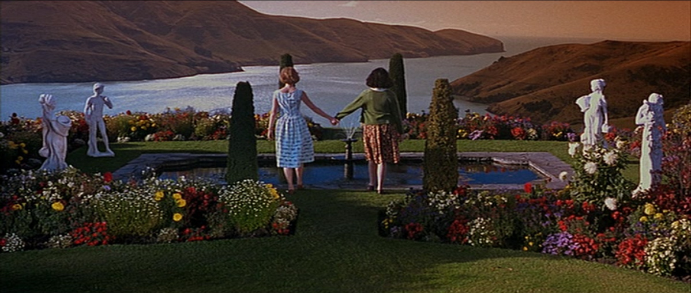
James Bennett: Research on Film, History and Sexuality
Co-editor of Making Film and Television Histories: Australia and New Zealand (I.B. Tauris, 2011)
Journal articles on 1954 Parker and Hulme case in Christchurch, New Zealand
Made into a feature film (drama-documentary) by Peter Jackson
‘Talking head’ on two documentaries
Discovery Channel
Reflections of the Past (Alexander Roman, 2010, 90 mins.)
https://www.youtube.com/watch?v=eVaqw-e73Ds
https://www.youtube.com/watch?v=b_oYT9mvChw

Slide 12
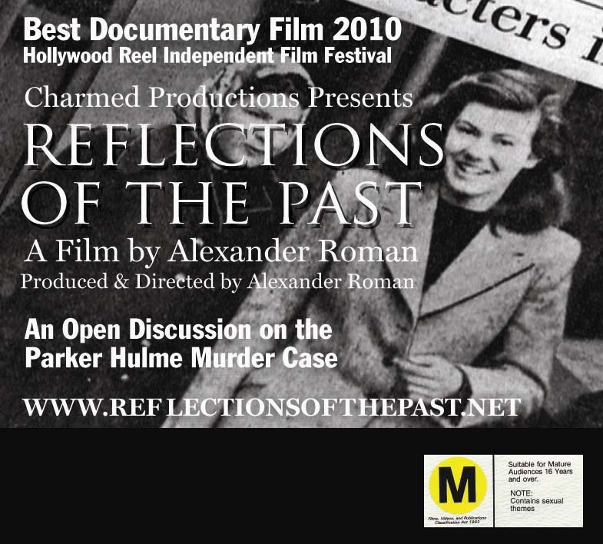
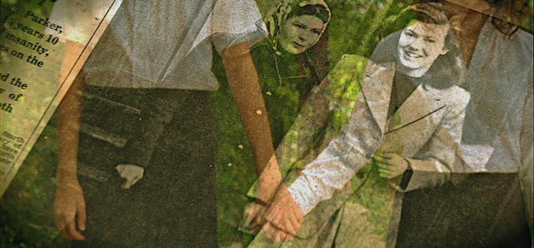
Reflections of the Past: Documentary on the Parker-Hulme Case
https://www.youtube.com/watch?v=b_oYT9mvChw

Slide 13
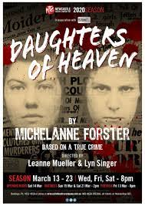
Daughters of Heaven Newcastle Theatre Company (2020)
https://www.youtube.com/watch?v=FX0UtSHeao8

Slide 14
Final points
Potential Honours and PhD topics based on research themes introduced in the course
Please be sure to complete required weekly readings located in Course Readings tab
Weekly five min scandal at the beginning of lectures to introduce you to non elite source types
Contact us by email if you have questions not answered in course outline

